Slide 1

Deploying
Your
Application
Daniel Villamizar
Senior Cloud Solutions Architect - MVP
@danielvillamizara – https://www.linkedin.com/in/danielvillamizara/

Slide 2


Module
overview
Understanding the Azure App Service
Deploying the application to an Azure App
Service

Slide 3
Understanding
the
Azure
App
Service

Slide 4

Microsoft
Azure
is
Microsoft’s
cloud
computing
service.
It
offers
SAAS,
PAAS
and
IAAS
and supports
many languages
and
application
types.

Slide 5
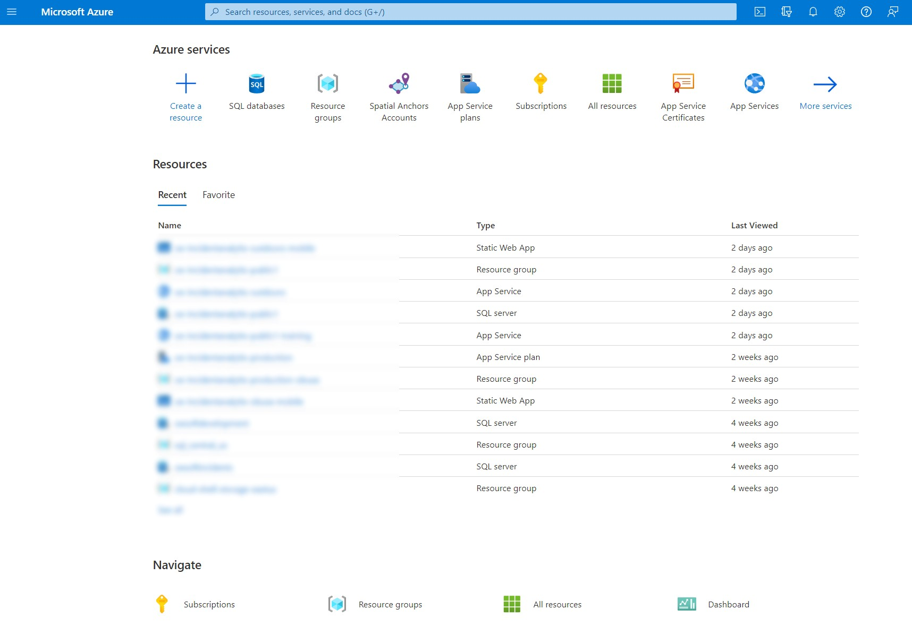
Azure
Portal

Slide 6


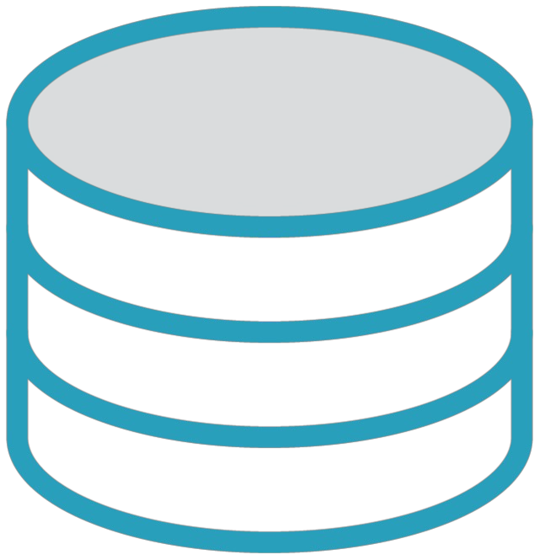



Azure
Services
Compute
services
Messaging
Identity
Data services
Storage
AI

Slide 7
Introducing
Azure
App
Service
Common Azure service
Host different types of
applications
Different stacks
Scalable

Slide 8
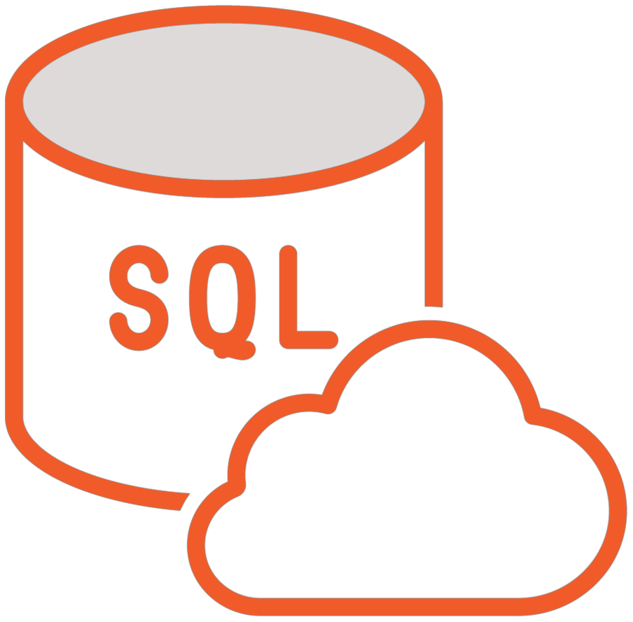
Azure SQL
-
-
-
Managed SQL in the cloud
Highly available
Scalable

Slide 9


Demo
Exploring the Azure Portal

Slide 10
Deploying
the
Application
to
an
Azure
App
Service

Slide 11
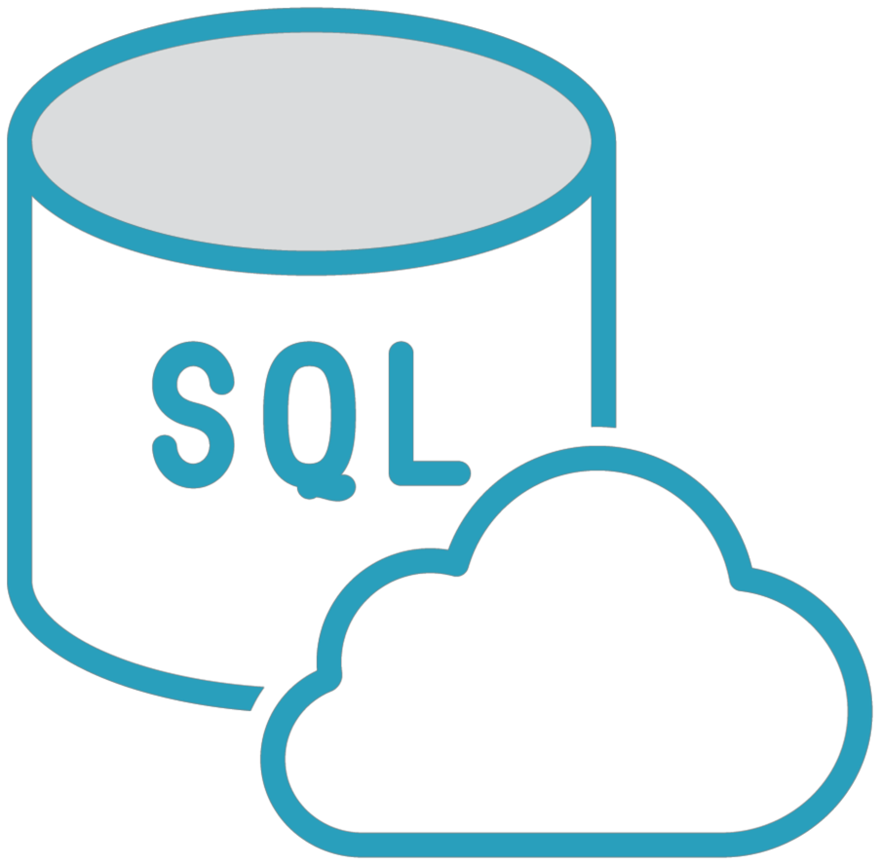
Required
Azure
Resources
ASP.NET Core
App
Blazor app

Slide 12

Hosting app (API + Blazor host)
-
Azure
App Service
Database
(API)
SQL
-
Azure

Slide 13
Alternative: Blazor WASM Standalone
-
-
-
No .NET requirement on the server
Static files
Can connect with remote API
• CORS
Often deployed to Azure Static Web
-
App

Slide 14
Deployment
Options
Visual Studio publish
CI/CD

Slide 15
Demo
Deploying the app and database to Azure

Slide 16
Summary
Azure is Microsoft’s cloud
Azure App Service can be application
Azure SQL can be used to database
platform
used to host the
host the

Slide 17

I
Congratulations
on
''
'
)
finishing
this
course!

